Slide 1


Raspberry Pi Hack : Introduction
Nasir Uddin’ PhD
https://github.com/nasirtrekker
https://www.linkedin.com/

Slide 2
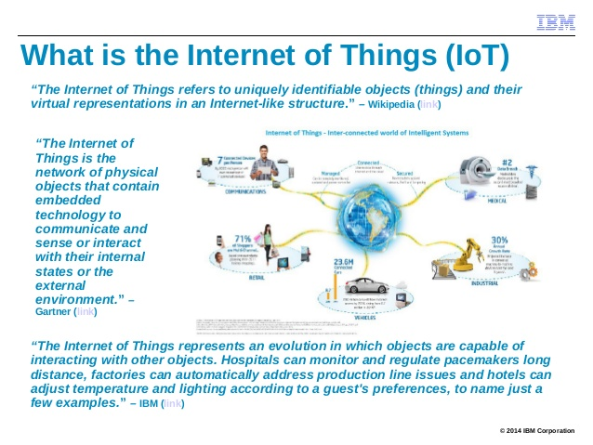

Slide 3


Slide 4


Slide 5


Slide 6
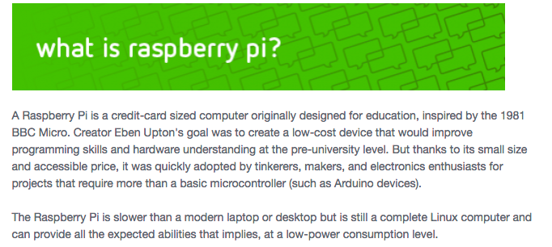

Can connect with sensors
Used as IOT learning platform
Can do fun projects
Kids learn programming
Low cost (~500 SEK )

Slide 7
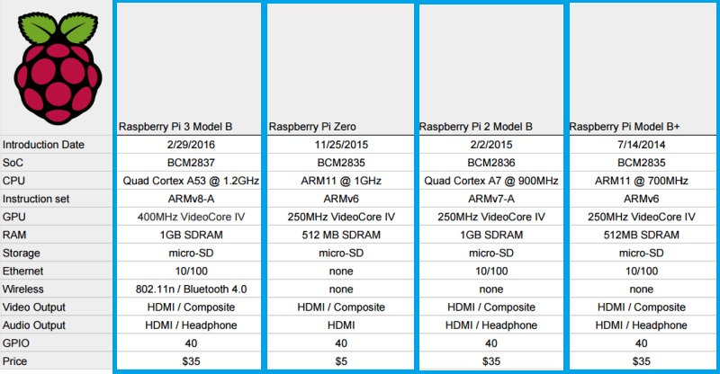
Raspberry pi : different models

Slide 8
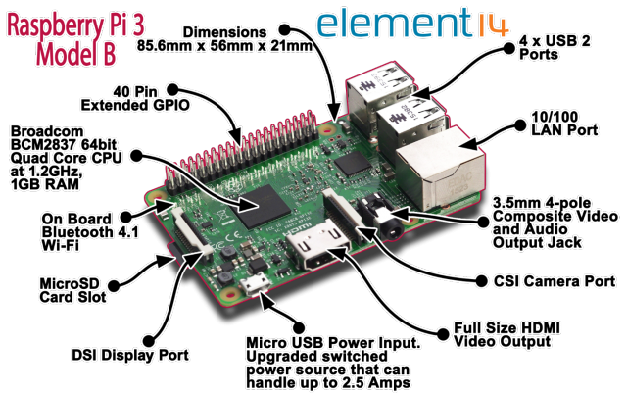

Slide 9
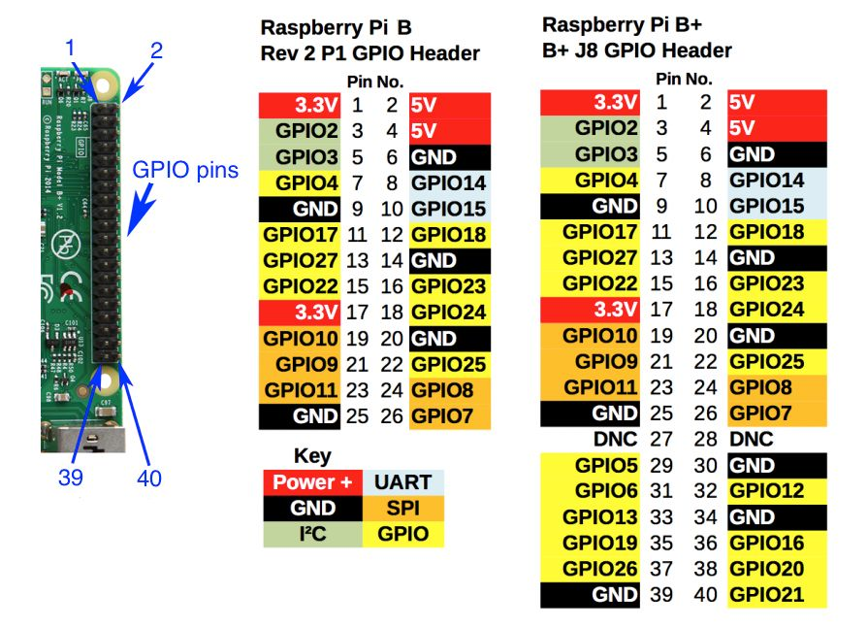
GPIO (General Purpose Input Output) Pins

Slide 10
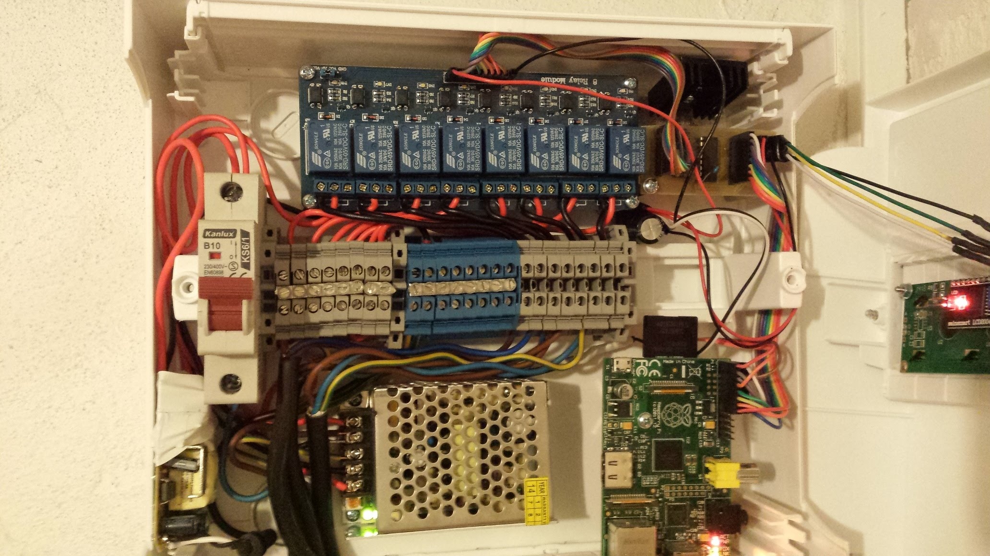
GPIO connected with Sensors

Slide 11
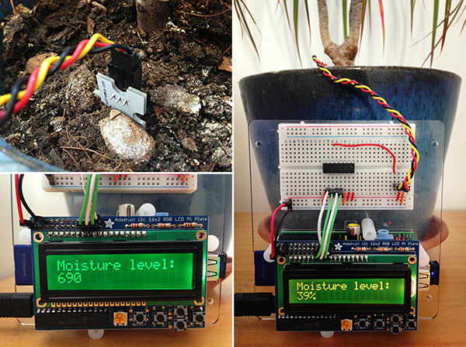
GPIO connected with Sensors

Slide 12


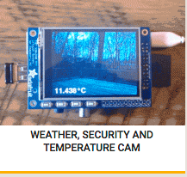
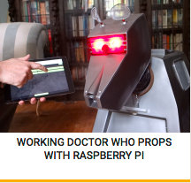
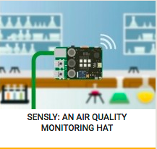
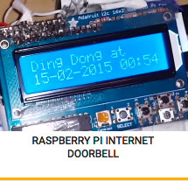
Some projects-1

Slide 13
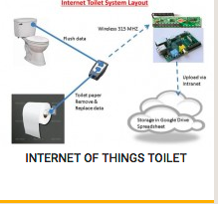

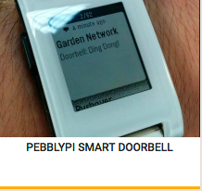
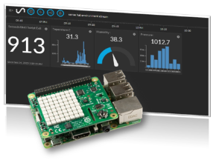

Some projects-2
Weather station

Slide 14
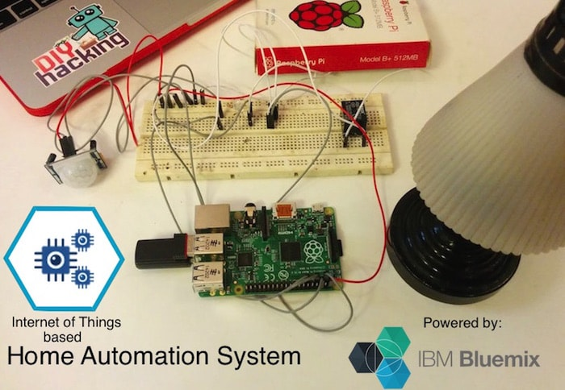

Slide 15
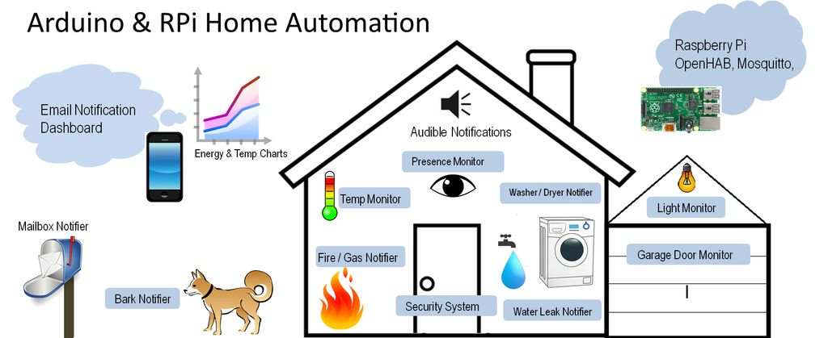

Some project: 3

Slide 16
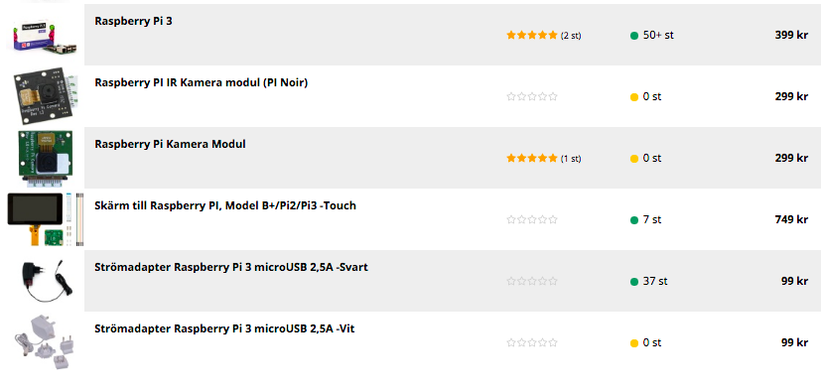
Price: Raspberry pi accessories (INET)

Slide 17

Price: senseHAT

Slide 18
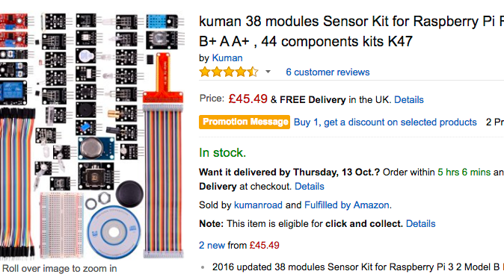
Price: Sensors kit

Slide 19
Set Up : Creating SD card
Step 1: Creating the SD card
Select the latest Raspbian image based off Debian Jessie: https://downloads.raspberrypi.org/raspbian_latest.
Note: The instructions in this course assume you are using the latest version of Raspbian based on Jessie. They will not work on the older Wheezy based images as there were significant changes between versions.
Write the image to the SD card using the instructions for your laptop OS (this takes some time) Note that you cannot just copy the .img file to the SD card, you need to use the instructions below:
Linux - https://www.raspberrypi.org/documentation/installation/installing-images/linux.md
Mac OS - https://www.raspberrypi.org/documentation/installation/installing-images/mac.md
Windows - https://www.raspberrypi.org/documentation/installation/installing-images/windows.md
Eject the SD card from your laptop and insert into the Raspberry Pi SD slot

Slide 20
Set Up : Booting the Raspberry pi
Step 2: Booting the Raspberry pi
The first time you boot the Raspberry Pi you will need to have a Keyboard, Mouse and screen connected to the Pi to be able to do the initial configuration. You will also need network connectivity (Ethernet or WiFi).
Quickstart guide Pi: https://www.raspberrypi.org/help/quick-start-guide/
Connect the power supply to the Raspberry Pi - you should see the boot sequence on the screen
To setup a remote connection you need the IP address of the Raspberry Pi. Enter the following command
hostname -I

Slide 21
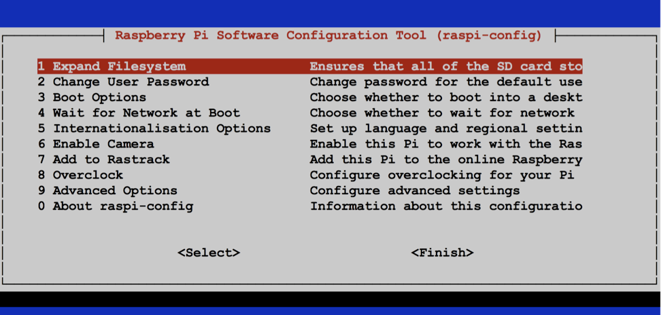
Set Up: Configuring
Step 3: Configuring
sudo raspi-config

Slide 22
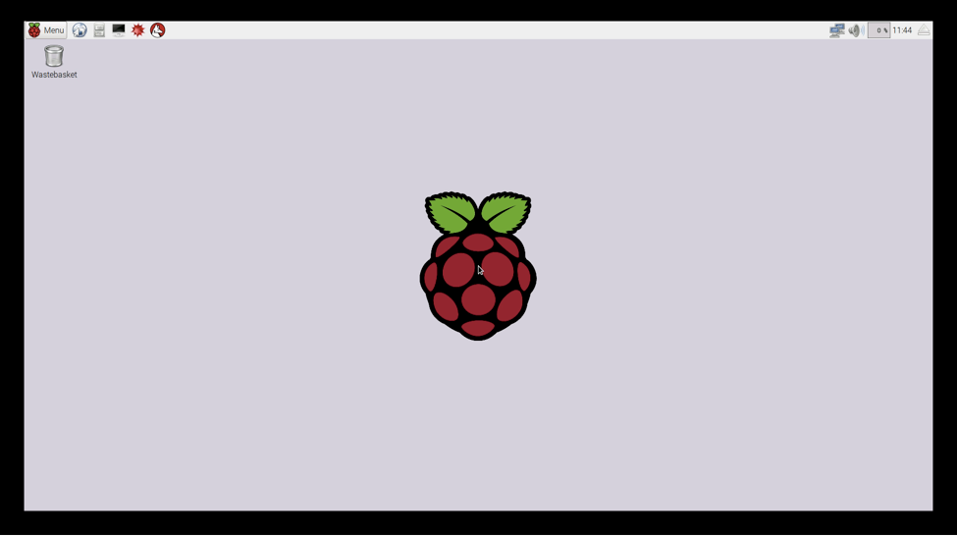
Primary desktop

Slide 23
Set Up: Updating
Step 4: Updating firmware and raspbian os
Enter the following commands in a terminal window:
sudo rpi-update
sudo reboot –n
After rebooting enter the following commands:
sudo apt-get update
sudo apt-get -y upgrade
sudo apt-get -y autoremove

Slide 24
Set Up: VNC server
Step 5: Setting up VNC server
VNC is a service that allows the Graphical User Interface of the Raspberry Pi to be access remotely using a VNC client.
Install the VNC server
sudo apt-get install -y tightvncserver autocutsel
2. Run VNC server
Runvncserver
3. Run at system start up (optional)
Enter the following command (next slide)

Slide 25
SSH from laptop with Ethernet cable
Connect your raspi with ethernet port to mac/pc
Open unix command prompt/terminal (mac)
Search rpi ip address with ‘arp –a ‘ command
SSH from laptop with ssh pi@ipaddress
You can also ssh with VNC viewer .
Pls check https://www.raspberrypi.org/documentation/remote-access/vnc/

Slide 26
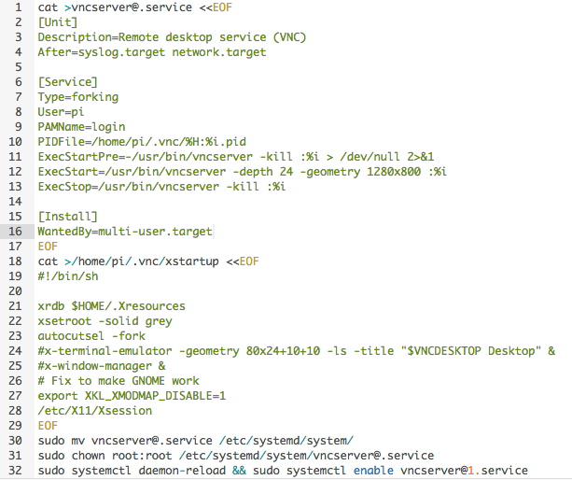
VNC server run at system startup (optional)

Slide 27

Astro-Pi

Slide 28
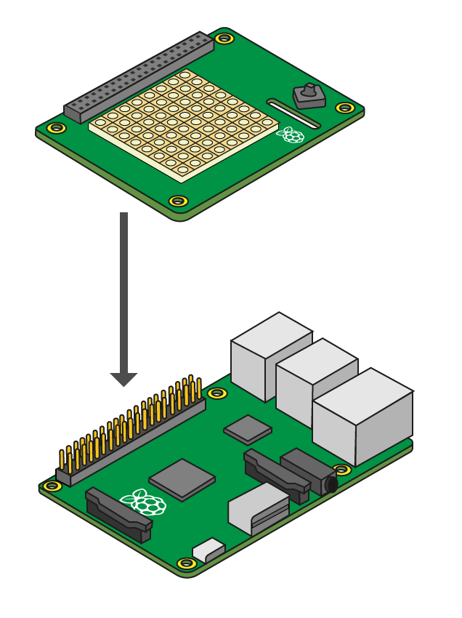

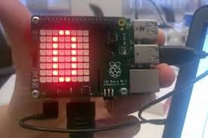
Assemble Astro-Pi/senseHAT

Slide 29
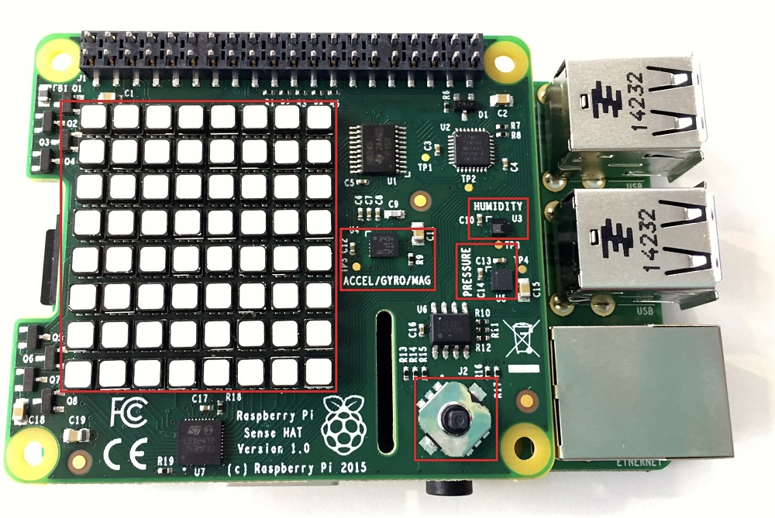
SenseHAT

Slide 30
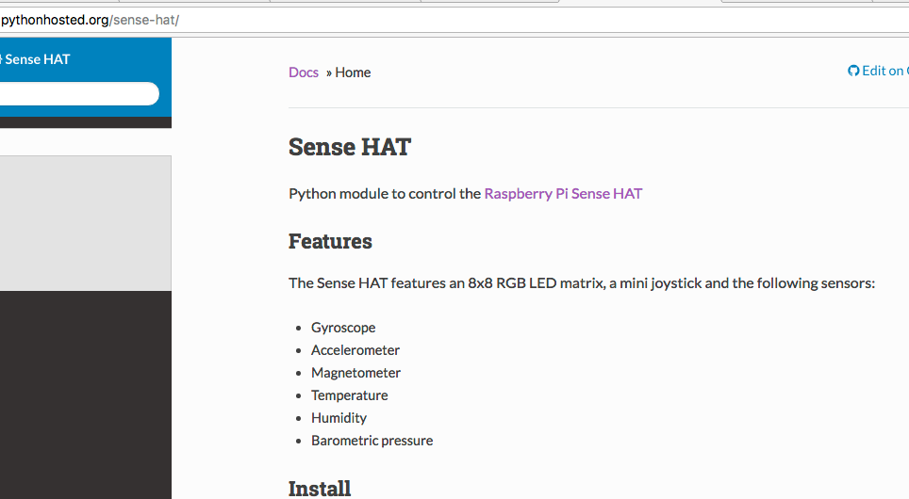
Python library senseHAT

Slide 31

SenseHAT: First Program
from sense_hat import SenseHat
sense = SenseHat()
sense.show_message(“ Hello, BIPS ")

Slide 32

senseHAT Temp
from sense_hat import SenseHat
sense = SenseHat()
sense.clear()
tmax = 27
tmin = tmax - 8
while True:
temp = sense.get_temperature()
print(temp)
temp = int(temp) - tmin
for x in range(0, 8):
for y in range(0, temp):
sense.set_pixel(x, y, 255, 0, 0)
for y in range(temp, 8):
sense.set_pixel(x, y, 0, 0, 0)

Slide 33

senseHAT Humidity
from sense_hat import SenseHat
sense = SenseHat()
sense.clear()
on_pixel = [255, 0, 0]
off_pixel = [0, 0, 0]
while True:
humidity = sense.get_humidity()
humidity = round(humidity, 1)
if humidity > 100:
humidity = 100.0
pixels = []
on_count = int((64 / 100.0) * humidity)
off_count = 64 - on_count
pixels.extend([on_pixel] * on_count)
pixels.extend([off_pixel] * off_count)
sense.set_pixels(pixels)

Slide 34
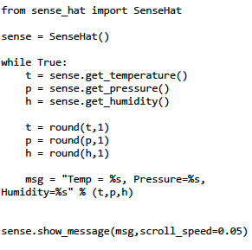
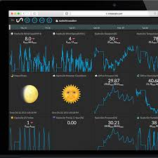
Environmental Sensing

Slide 35
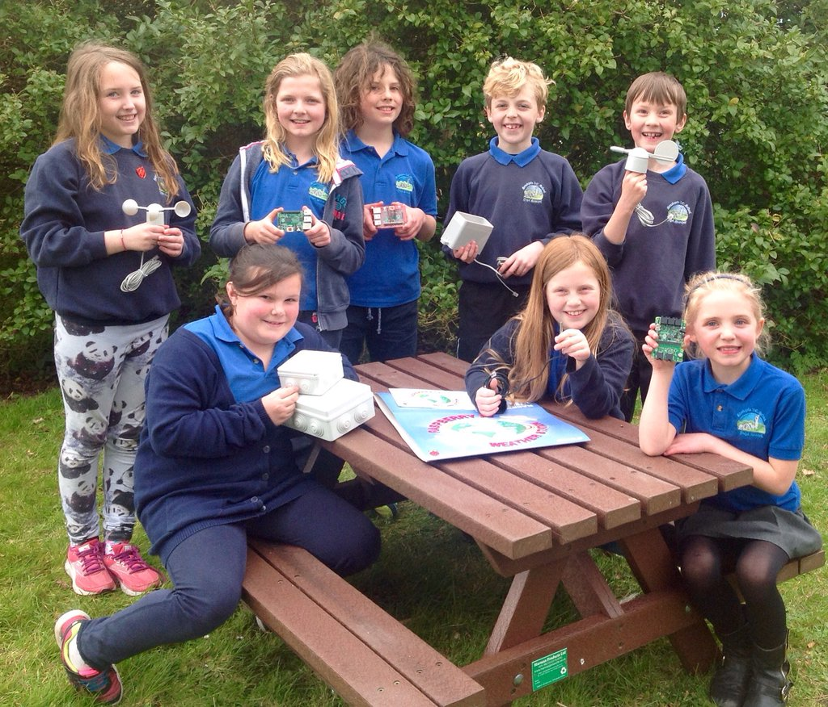
Lets hack now!!

Slide 36
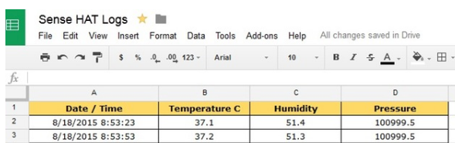
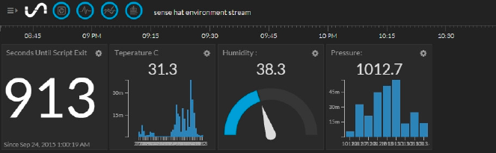
Mini Weather Station
Google Doc:
https://www.hackster.io/idreams/make-a-mini-weather-station-with-a-raspberry-pi-2-and-sense-447866
Initial State Cloud Service:
https://www.element14.com/community/docs/DOC-82169/l/raspberry-pi-weather-station-project

Slide 37
References
https://www.raspberrypi.org/
https://astro-pi.org/
https://learn.adafruit.com/
http://lifehacker.com/how-to-build-a-portable-hacking-station-with-a-raspberr-1739297918
http://www.itpro.co.uk/mobile/21862/raspberry-pi-top-22-projects-to-try-yourself

